Slide 1
Bishop Blanchet Robot Controls
FRC Rapid React 2022

Slide 2
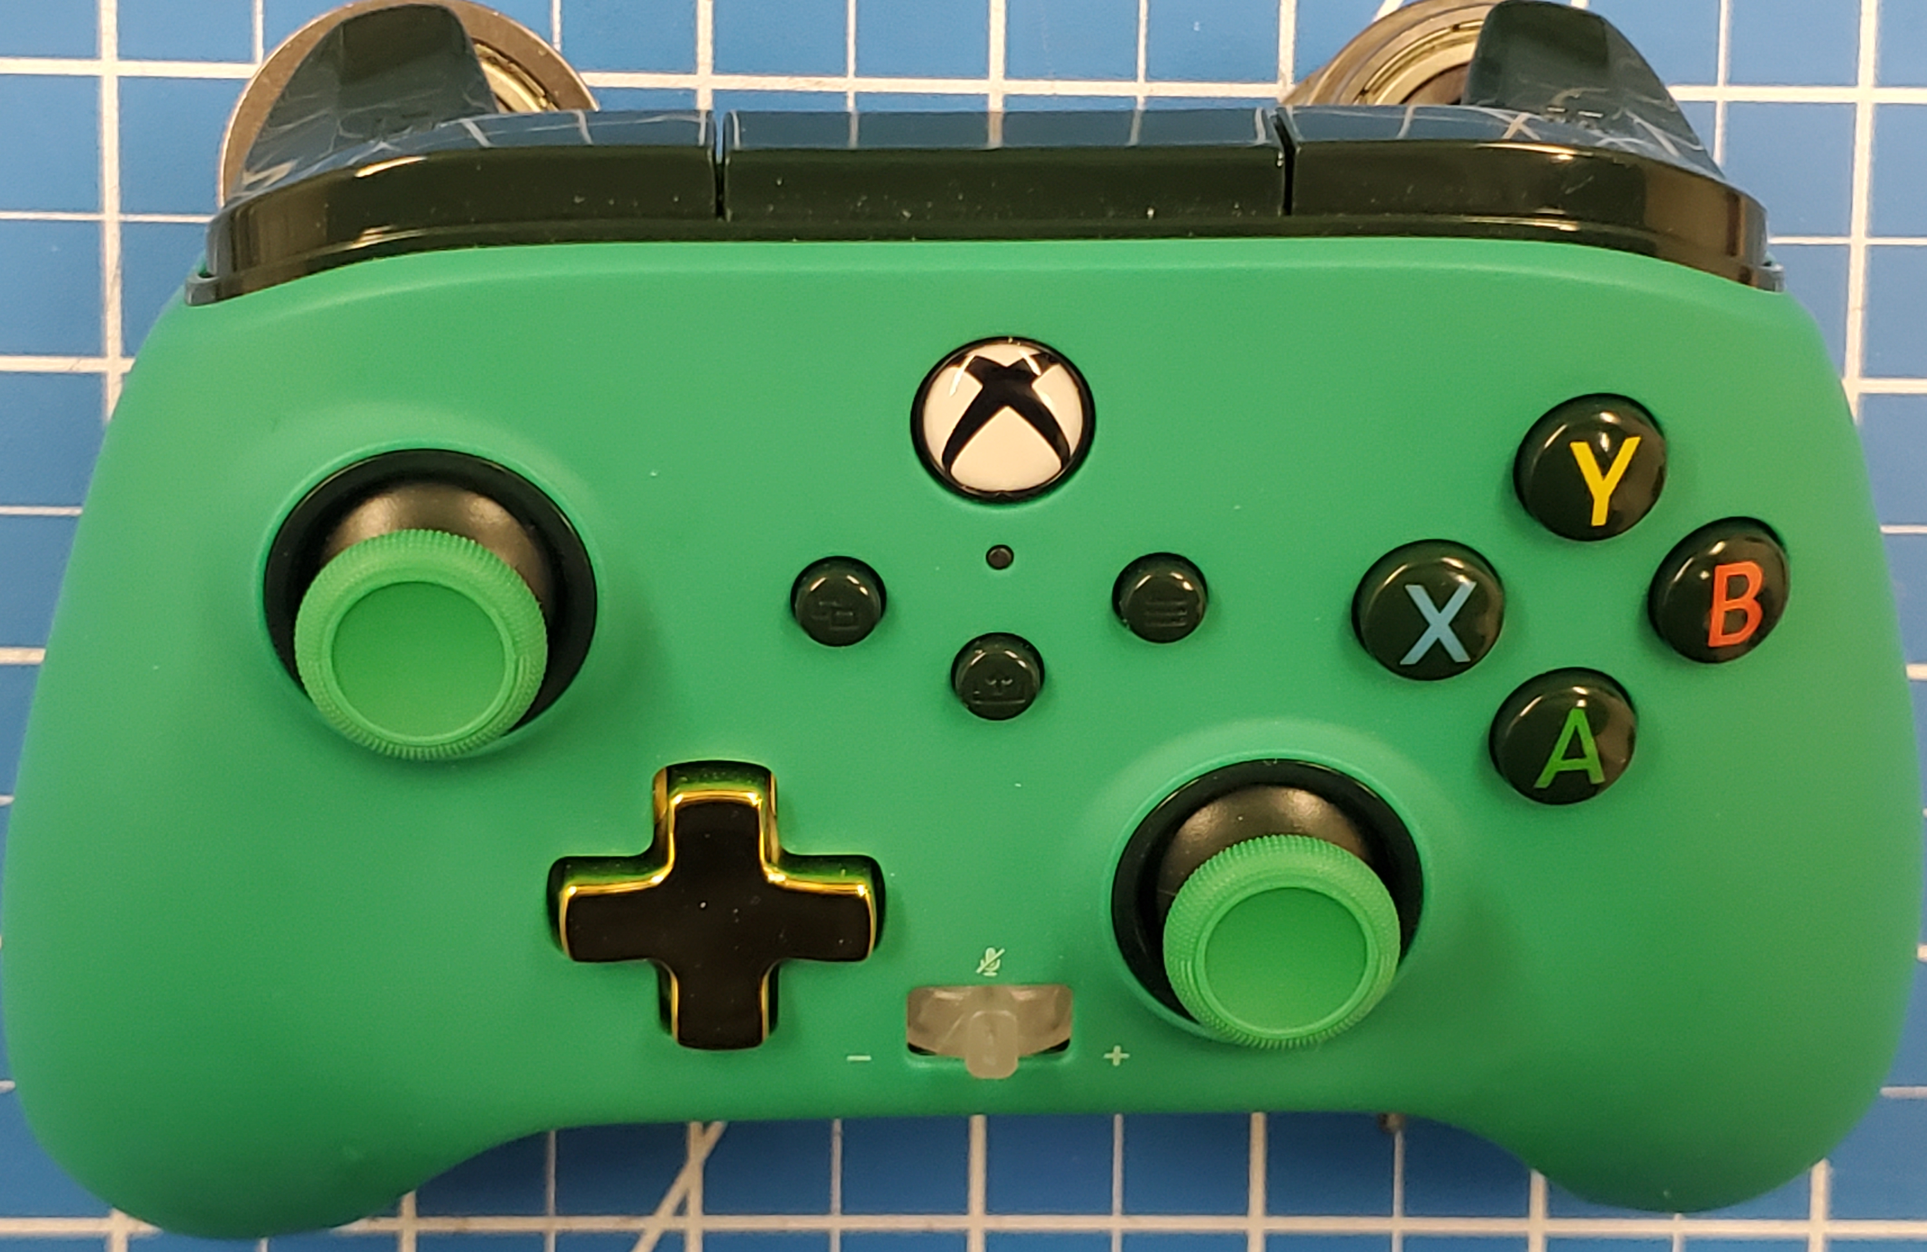
Driver Controller Actions
Left Joystick Button:
Arcade robot drive

Slide 3
Button Board Automated Commands
Angle Arm
Telescoping Arm
Jaws
Ball Control
Connect
Mid
Fwd High
Intake
Hang?
High
Rev High
Store
Store
Traversal
Fwd Low
Retrieve
Fwd Intake
Shoot

Slide 4
Co-driver Controller Actions – overrides
Left Bumper: Stage 1 Ball Storage single speed (while depressed)
Right Bumper: Ball Retrieval
single speed (while depressed)
Back Button: Stage 2
Ball Storage – single speed
(while depressed)
Start Button: Stage 2
Ball Retrieval – single speed
(while depressed)
Right Trigger: Ball Shooter
variable speed
Left Trigger: Ball Intake
variable speed
Y Button: Angle Arm
top pneumatic in/out
(when released)
Left Joystick Button:
Ball Jaws up/down
variable speed
B Button: Angle Arm
bottom pneumatic in/out
(when released)
Right Joystick Button:
Telescoping Arm up down
variable speed

